Slide 1









Whiteboardmaths.com
7
2
1
5
© 2004 All rights reserved

Slide 2


The Rules for Indices:
Multiplication
index 3
index 4
base 5
3⁴
5³
base 3
Consider the following:
3² x 3³ = 3 x 3 x 3 x 3 x 3 = 3⁵ (base 3)
2⁴ x 2³ = 2 x 2 x 2 x 2 x 2 x 2 x 2 = 2⁷ (base 2)
5³ x 5² x 5 = 5 x 5 x 5 x 5 x 5 x 5 = 5⁶ (base 5)
For multiplication of numbers in the same base you?
add the indices
Generalising gives:
Multiplication Rule
a^{m} x a^{n} = a^{m+n}
Write the following as a single exponent:
2³ x 2⁵
3² x 3⁵
4⁶ x 4⁴
5³ x 5¹
6³ x 6³
8³ x 8⁹
2⁷ x 2²
2⁸
3⁷
4¹⁰
5⁴
6⁶
8¹²
2⁹

Slide 3
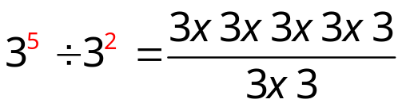

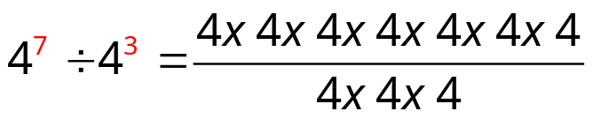

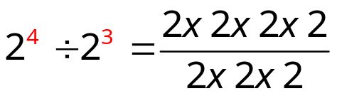

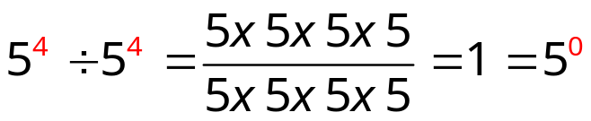
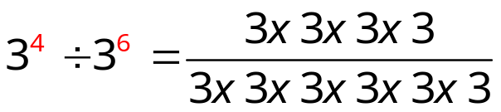
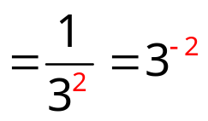
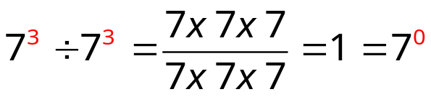
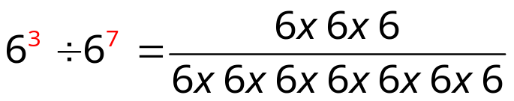
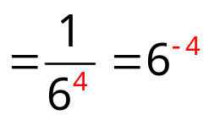
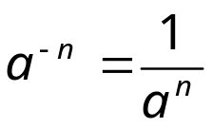
The Rules for Indices
Division
Consider the following:
For division of numbers in the same base you?
subtract the indices
Generalising gives:
Division Rule
a^{m} ÷ a^{n} = a^{m-n}
Using this convention for indices means that:
and
Generalising gives:
In general:
a⁰ = 1
Negative Index Rule

Slide 4
The Rules for Indices:
Powers
Consider the following:
(3²)³ = 3 x 3 x 3 x 3 x 3 x 3 = 3⁶ (base 3)
(2⁴)² = 2 x 2 x 2 x 2 x 2 x 2 x 2 x 2 = 2⁸ (base 2)
(5³)³ = 5 x 5 x 5 x 5 x 5 x 5 x 5 x 5 x 5 = 5⁹ (base 5)
To raise an indexed number to a given power you?
multiply the indices
Generalising gives:
Power Rule
(a^{m})^{n} = a^{mn}
Write the following as a single exponent:
(2²)³
(3²)²
(4³)⁴
(5³)²
(6⁻³)²
(8⁻²)²
(2⁷)⁻²
2⁶
3⁴
4¹²
5⁶
6⁻⁶
8⁻⁴
2⁻¹⁴

Slide 5
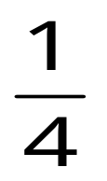













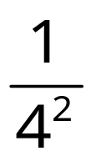
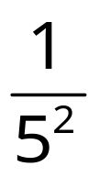
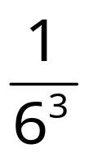
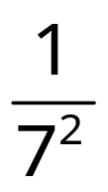
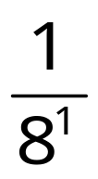
Multiplication Rule
a^{m} x a^{n} = a^{m+n}
a⁰ = 1
Division Rule
a^{m} ÷ a^{n} = a^{m-n}
Negative Index Rule
a^{-n} = 1/a^{n}
Write the following as a single exponent and evaluate
2⁵ ÷ 2²
2⁶ ÷ 2²
2³ ÷ 2³
3⁶ ÷ 3⁶
2³ ÷ 2⁴
3⁵ ÷ 3⁶
4⁷ ÷ 4⁹
2³
2⁴
2⁰
3⁰
2⁻¹
3⁻¹
4⁻²
8
16
1
1
1/2
1/3
1/16
Write the following fractions in index form.
Write the following as fractional powers.

Slide 6
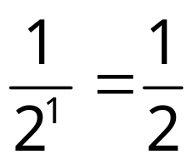
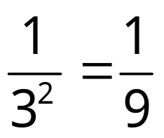
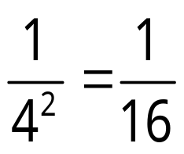
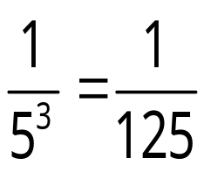
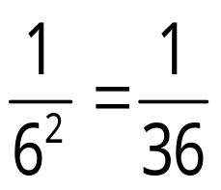
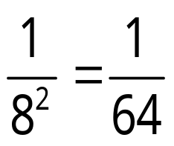
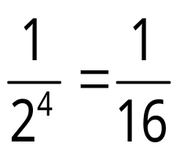
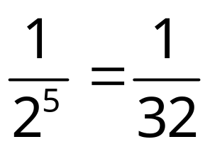
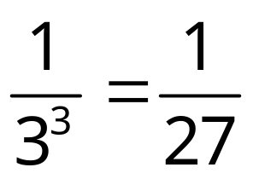
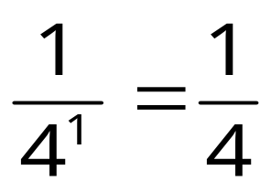
Write the following as a single exponent and evaluate:
2² x 2⁻³
3⁴ x 3⁻⁶
4⁻⁴ x 4²
5² ÷ 5⁵
6³ ÷ 6⁵
8⁷ ÷ 8⁹
2⁴ ÷ 2⁸
2⁻¹
3⁻²
4⁻²
5⁻³
6⁻²
8⁻²
2⁻⁴
Write the following as a single exponent and evaluate:
2⁻³ x 2⁻²
3⁻¹ x 3⁻²
4⁻⁴ x 4³
2⁻³ ÷ 2²
7⁻¹ ÷ 7⁻¹
4³ ÷ 4⁻¹
2⁻⁵
3⁻³
4⁻¹
2⁻⁵
7⁰ = 1
4⁴ = 256

Slide 7
Indices in Expressions
Simplify each of the following:
1
y² x y³
y⁵
2
2y² x 3y⁴
6y⁶
Raise the number to the given power and multiply the indices.
3
5p² x 3p³ x 2p
30p⁶
4
8k³ x 2k⁻⁴ x 3k²
48k
5
ab² x a²b³ x a²b⁴
a⁵b⁹
6
2a³b² x 3ab⁴ x 2a²b²
12a⁶b⁸
7
(2pq²)²
= 2pq² x 2pq²
= 4p²q⁴
8
(3a²b³)²
= 3a²b³ x 3a²b³
= 9a⁴b⁶
9
(5m²n³)²
= 5m²n³ x 5m²n³
= 25m⁴n⁶
10
(2pq²)³
= 2pq² x 2pq² x 2pq²
= 8p³q⁶
11
(3a²b³)⁴
= 81a⁸b¹²
12
(2m²n³)⁵
= 32m¹⁰n¹⁵

Slide 8
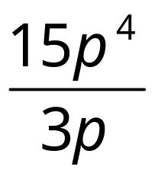
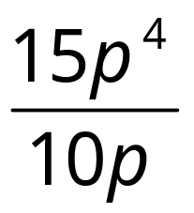
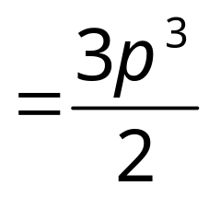
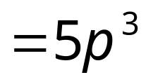
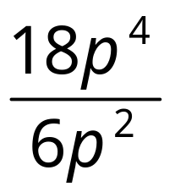
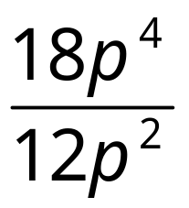
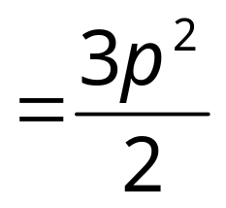
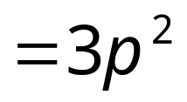
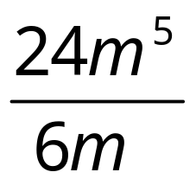
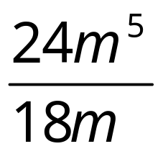
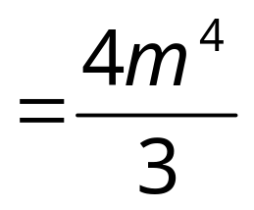

Simplify the following:
5
3
3
3
1
4
1
1
2
1
3
2
3
2
2
5
1
1
2
1
4
4
4
4
3
6
1
1
3
1

Slide 9
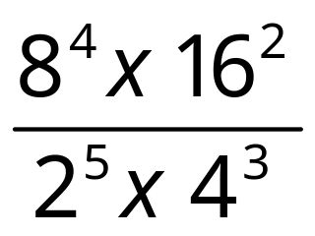
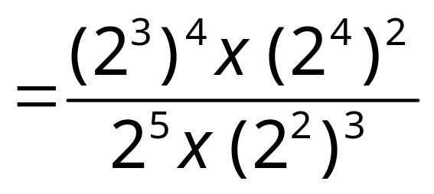
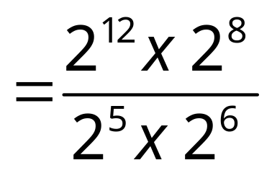
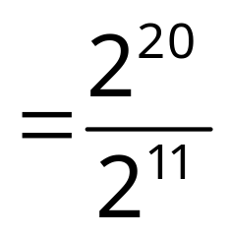
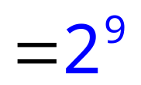
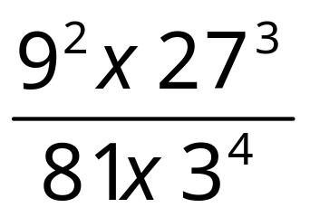
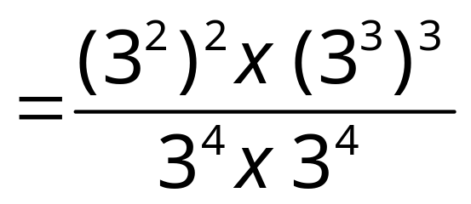
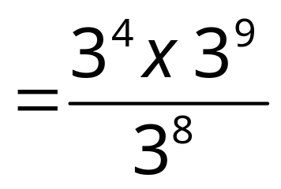
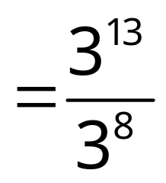
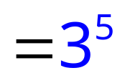
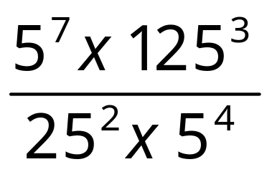
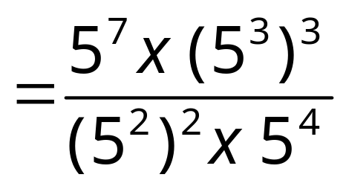
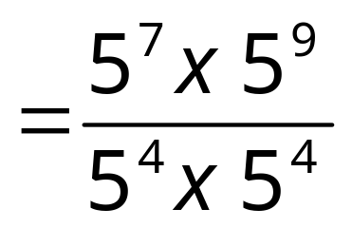


Write the following as a power of 2
Write the following as a power of 3
Write the following as a power of 5

